Slide 1
Get Fit Right & Crypto Tracker
By: Ahmed, Edgar, Rameez, Zakee

Slide 2
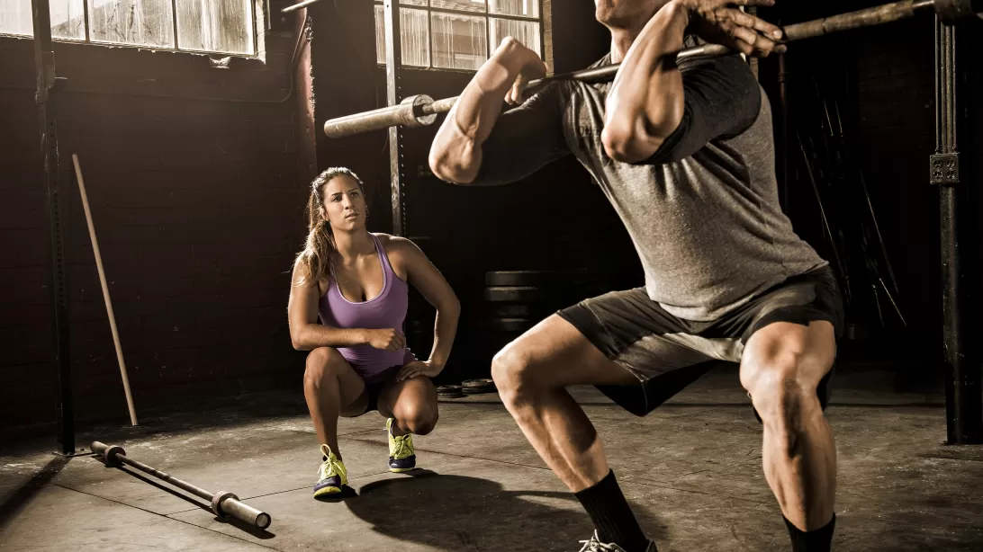
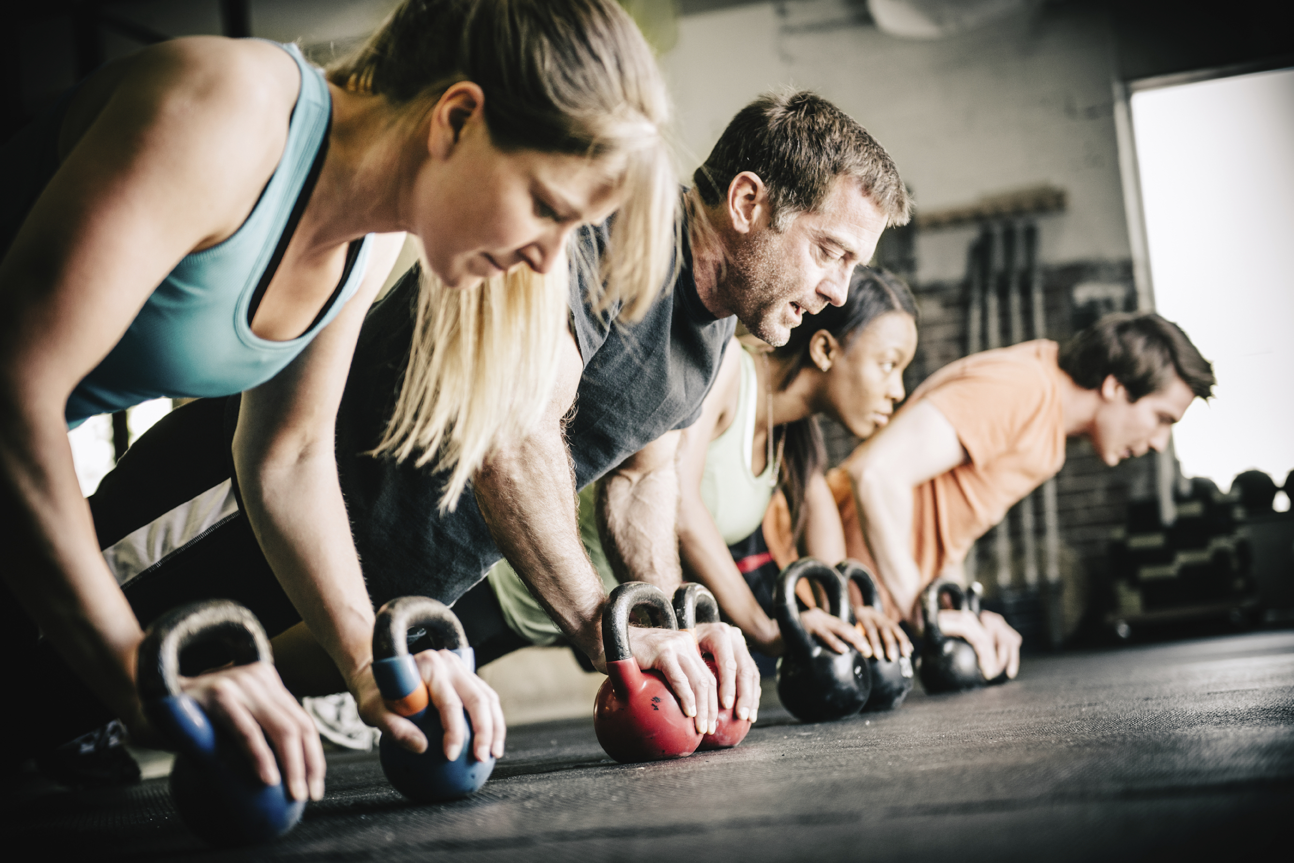
Get Fit Right
Current Issues
People working out incorrectly
The Fix
Track posture
Technology we are developing
Application that tracks people working out
Analysis posture
Real time results

Slide 3
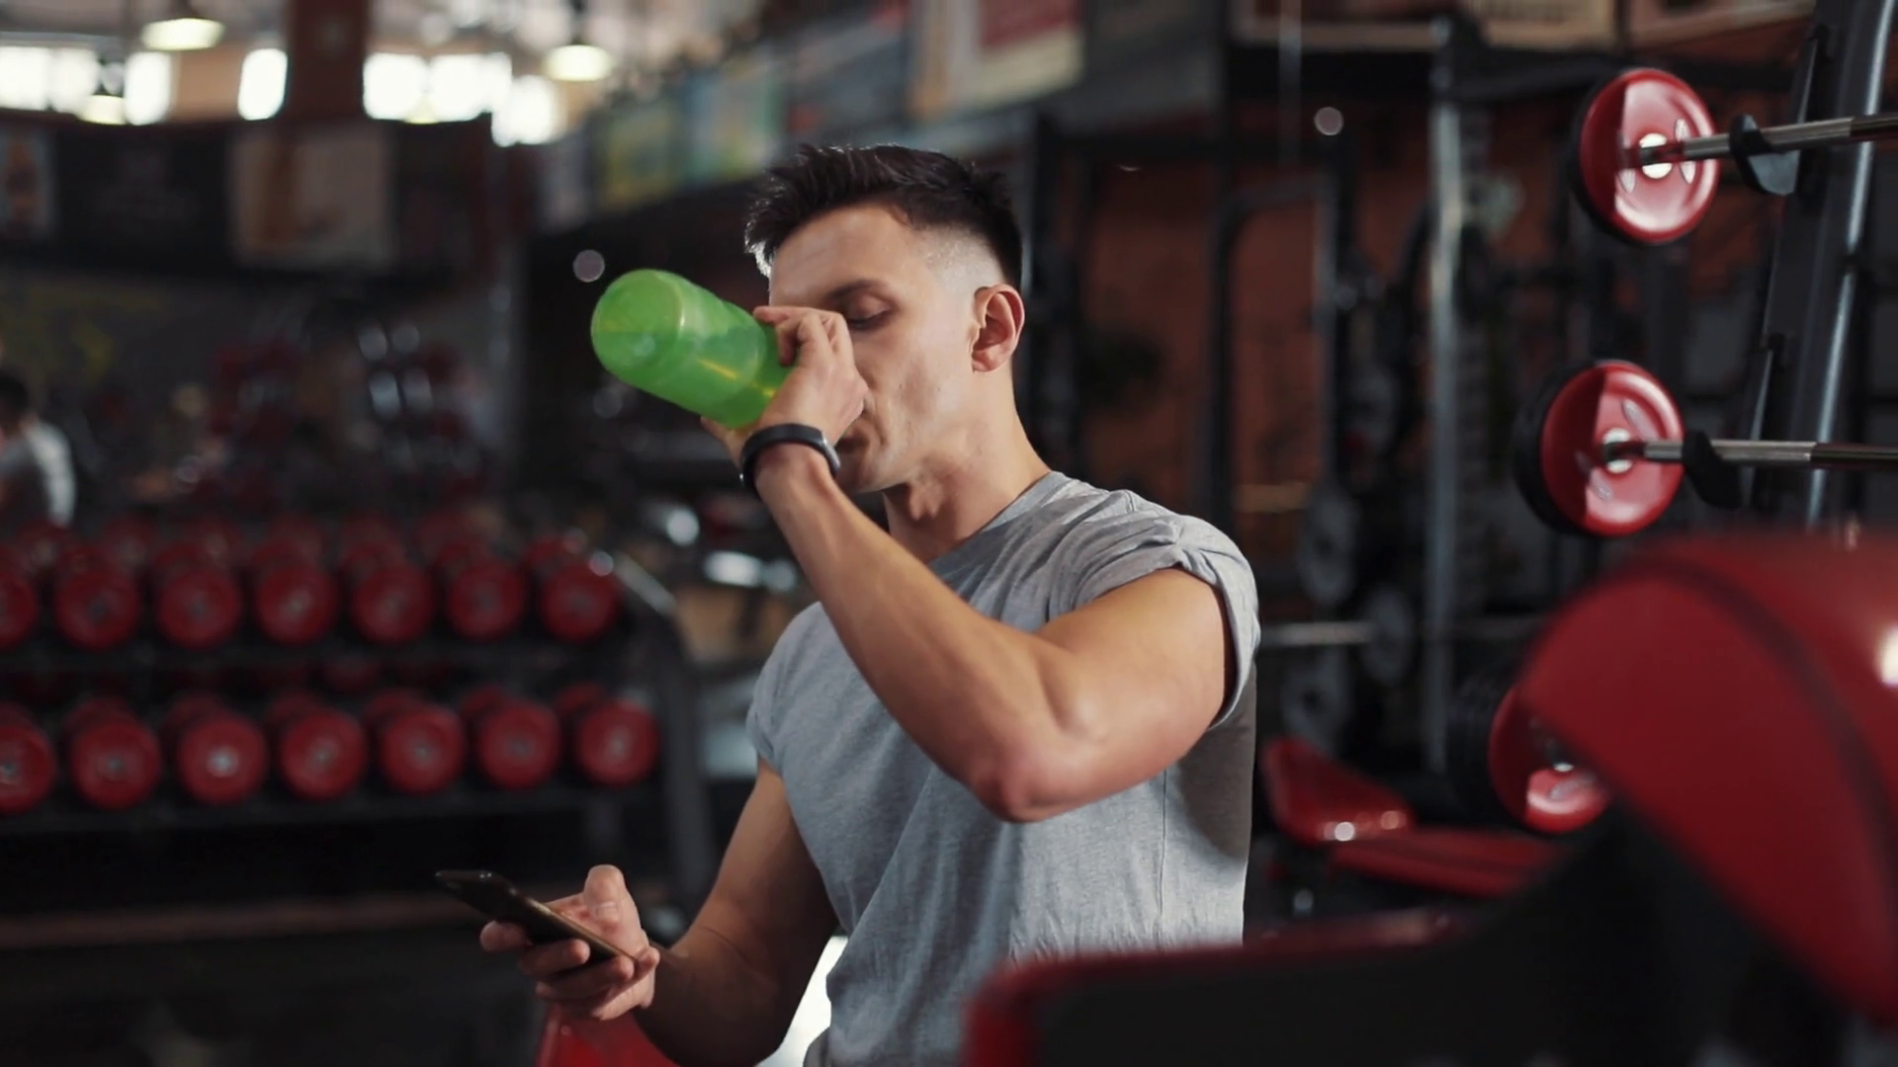
Design Goals
UI must be easy to use and good to look at
Fast reconnection to server in event of connection loss
Speed over security
Persistent data/Recovering data
Logged into account

Slide 4
Subsystems
Camera
Tracker
Database
Workout
Logger
Analyzer
Machine Learning
User Interface

Slide 5
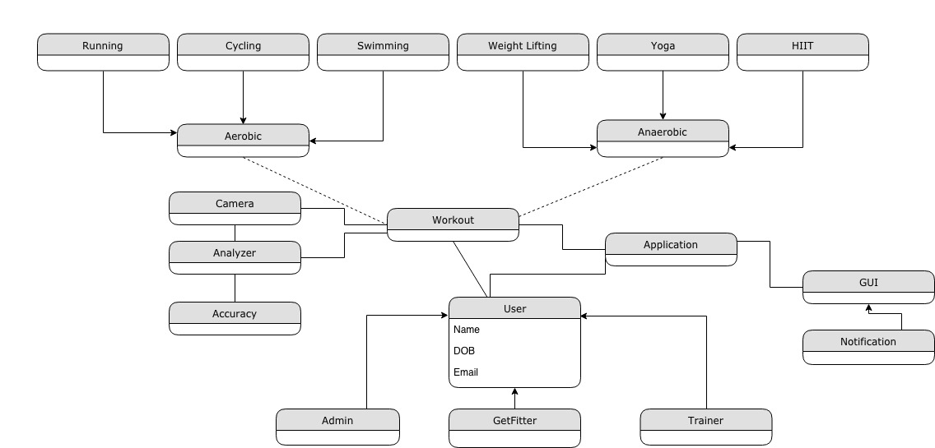
System Diagram

Slide 6



Cryptocurrency Tracker
All major cryptocurrencies
Daily quick info
High, low, volume, bid, ask
Daily, monthly, all time graphs
7 major currencies
Relevant News Articles

Slide 7
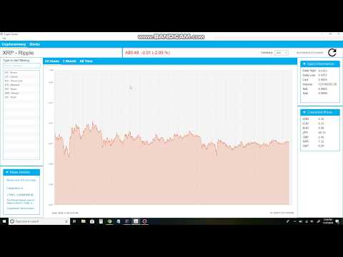
Demo

